Slide 1


Travel Review Ratings
Learn
Understand
Apply
Subject: Machine Learning
Presented By,
Rajaraman Ganesan – 251056279 (M.Eng)
Vatsal Shah – 251041322 (M.Eng)
Department of Electrical & Computer Engineering (M.Engg)
Western University, Canada

Slide 2
Objective & Goal
Dataset Overview
Approach Design
Visualization Overview
Machine Learning Model
Results
Amazon SageMaker
Future Work & *QR Code

Slide 3
Objective & Goal
Understand the process & difference by applying algorithms with custom models and pre-build libraries in Python
Apply algorithm in most-demanded languages in the industry - Python & R
Compare process, results and time complexity
Use Amazon SageMaker - understand the services

Slide 4
Objective & Goal
Dataset Overview
Approach Design
Visualization Overview
Machine Learning Model
Results
Amazon SageMaker
Future Work & *QR Code

Slide 5

Dataset overview
Travel planning has become one of important commercial use.
Many tourists look for some places like malls, restaurants or vacation spots, etc. online in recent times.
Online review plays a critical role in the tourism industry, which mainly offers services and focuses on customer satisfaction.
Reviews on attractions across Europe are considered.
Google user rating ranges from 1 to 5 and average user rating per category is calculated.
No Kaggle Kernels!!!

Slide 6
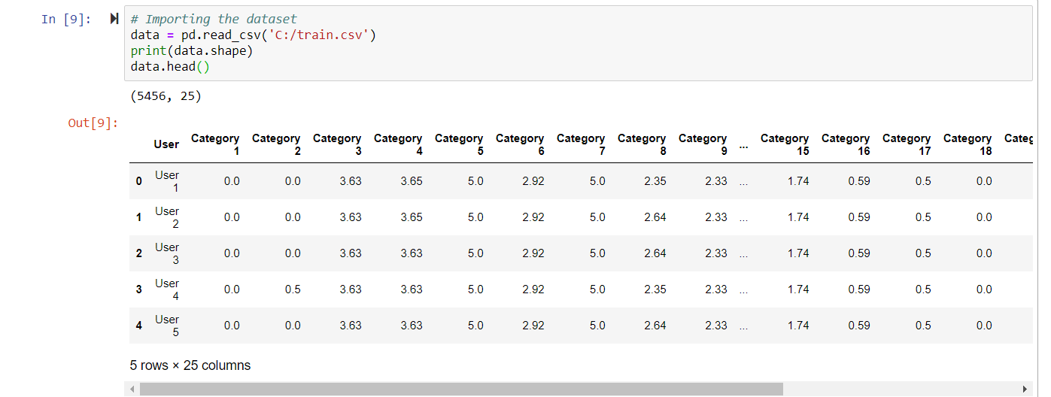
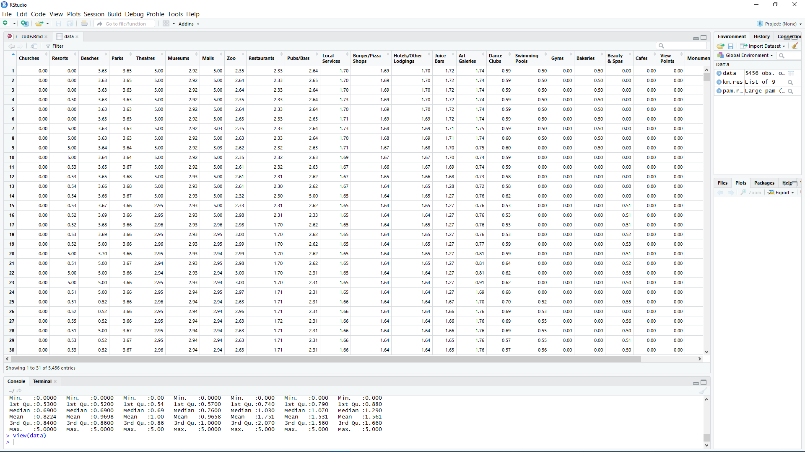
Oriented: UCI Machine Learning Repository (Link) Attributes : 25 Tuples: 5456
Attribute 1 : Unique user id
Attribute 2 : Average ratings on churches
Attribute 3 : Average ratings on resorts
Attribute 4 : Average ratings on beaches
Attribute 5 : Average ratings on parks
Attribute 6 : Average ratings on theatres
Attribute 7 : Average ratings on museums
Attribute 8 : Average ratings on malls
Attribute 9 : Average ratings on zoo
Attribute 10 : Average ratings on restaurants
Attribute 11 : Average ratings on pubs/bars
Attribute 12 : Average ratings on local services
Attribute 13 : Average ratings on burger/pizza shops
Attribute 14 : Average ratings on hotels/other lodgings
Attribute 15 : Average ratings on juice bars
Attribute 16 : Average ratings on art galleries
Attribute 17 : Average ratings on dance clubs
Attribute 18 : Average ratings on swimming pools
Attribute 19 : Average ratings on gyms
Attribute 20 : Average ratings on bakeries
Attribute 21 : Average ratings on beauty & spas
Attribute 22 : Average ratings on cafes
Attribute 23 : Average ratings on view points
Attribute 24 : Average ratings on monuments
Attribute 25 : Average ratings on gardens

Slide 7
Objective & Goal
Dataset Overview
Approach Design
Visualization Overview
Machine Learning Model
Results
Amazon SageMaker
Future Work & *QR Code

Slide 8
Process Design
Unsupervised learning approach
Don't have a preliminary info on output values
Explore data to find some intrinsic structures in them
Use of clustering algorithm technique like k-means algorithm.

Slide 9
Approach Design
Preparation of data
Data Visualization
Applying model
Apply custom model
Evaluate model

Slide 10
Objective & Goal
Dataset Overview
Approach Design
Visualization Overview
Machine Learning Model
Results
Amazon SageMaker
Future Work & *QR Code

Slide 11
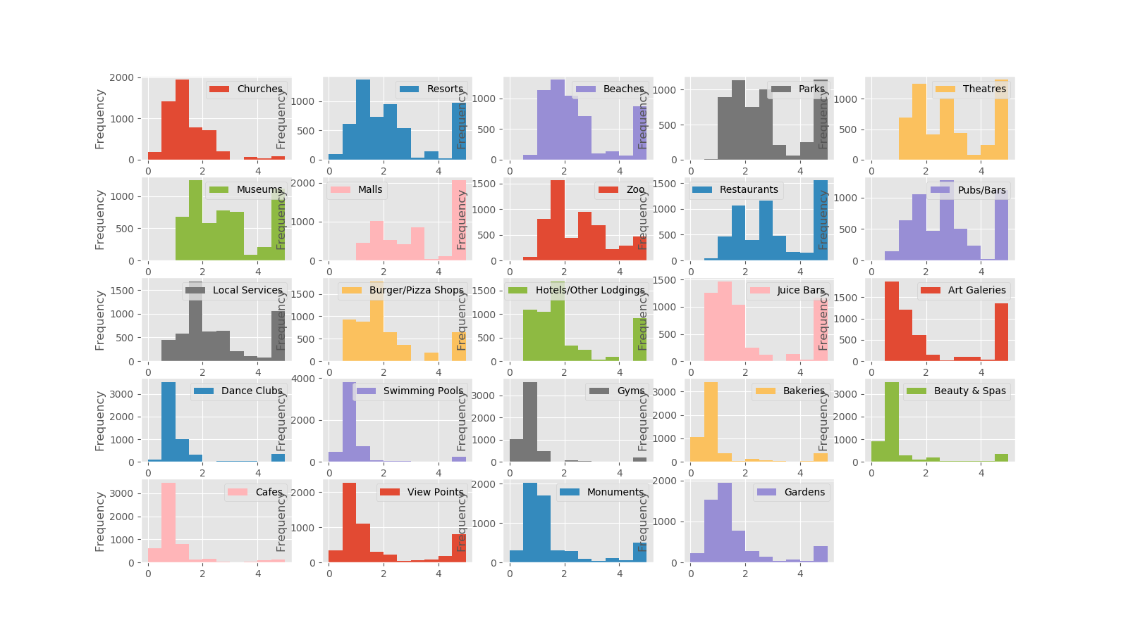
Visualization Overview
Shows 24 categories reviewed by users with hist diagram
(Screenshot taken during evaluation process)

Slide 12
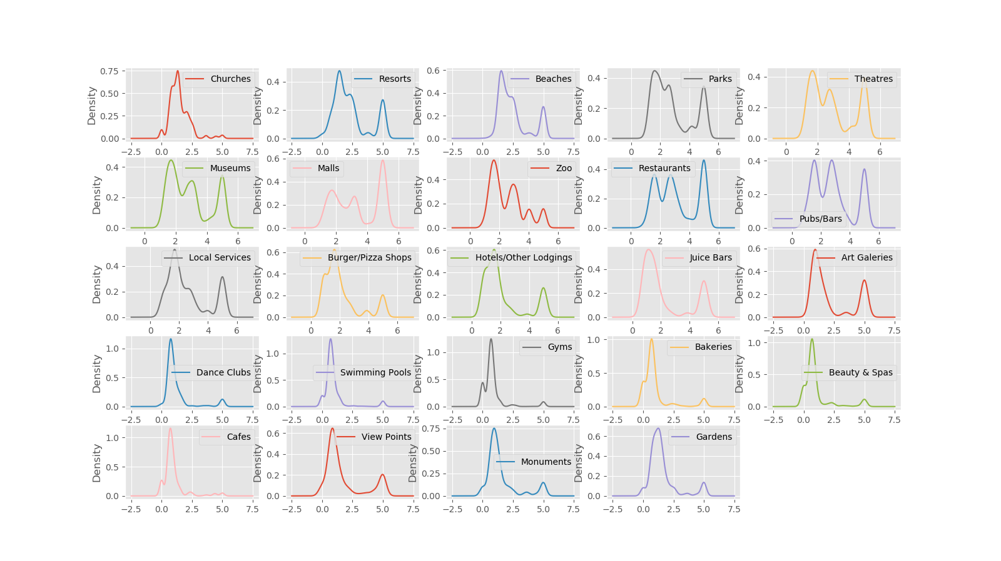
Continue…
Shows 24 categories reviewed by users with density diagram
(Screenshot taken during evaluation process)

Slide 13
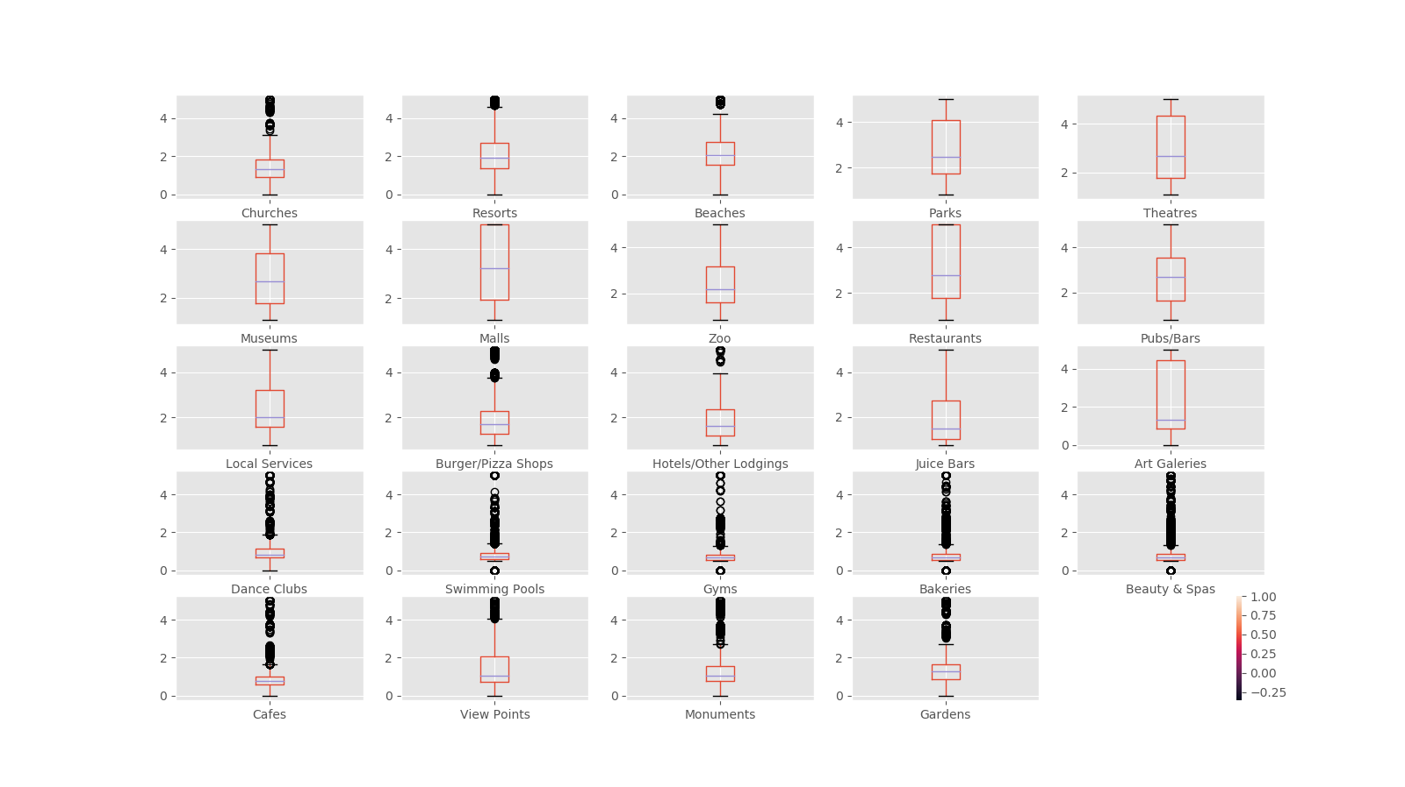
Continue…
Shows 24 categories reviewed by users with box plot diagram
(Screenshot taken during evaluation process)

Slide 14
Objective & Goal
Dataset Overview
Approach Design
Visualization Overview
Machine Learning Model
Results
Amazon SageMaker
Future Work & *QR Code

Slide 15
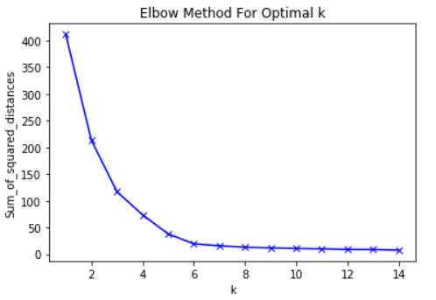
K-Means Algorithm
Choose no: of clusters
Initialization
Assign cluster
Move centroid
Optimization
Convergence
Within-cluster sum of squares is a measure of the variability of the observations within each cluster
Idea behind using elbow method to choose after which WSS is almost constant.

Slide 16
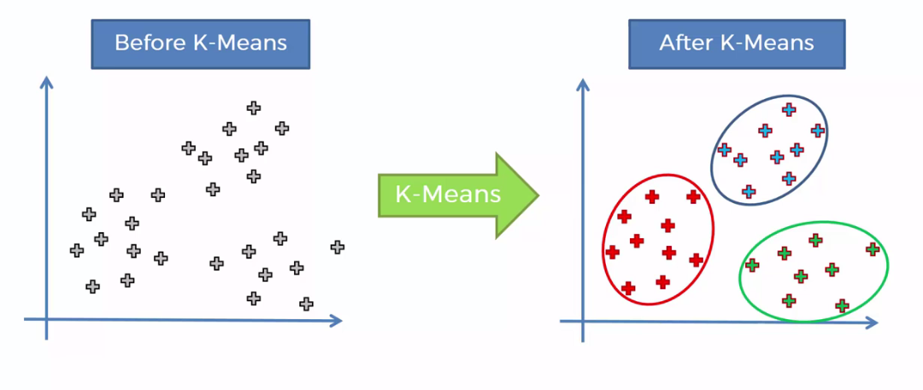
K-Means Algorithm
Choose no: of clusters
Initialization
Assign cluster
Move centroid
Optimization
Convergence
Initialize k points, randomly
Value of clusters are determined by elbow curve.

Slide 17
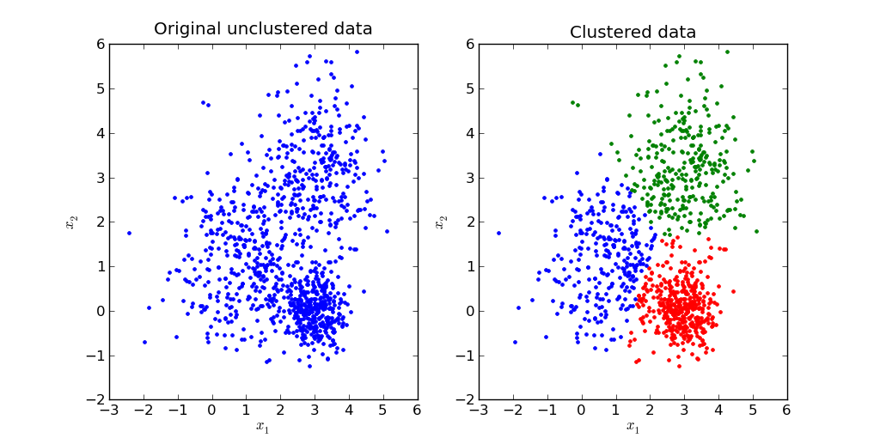
K-Means Algorithm
Choose no: of clusters
Initialization
Assign cluster
Move centroid
Optimization
Convergence
Dist. between data points and centroid are computed.
Based on min. Distance, data are divided into groups.

Slide 18
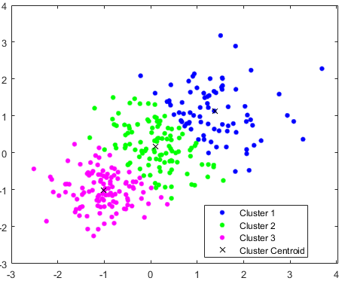
K-Means Algorithm
Choose no: of clusters
Initialization
Assign cluster
Move centroid
Optimization
Convergence
Compute the mean of all three dots.
Reposition blue, green, pink cluster centroid to this mean.

Slide 19
K-Means Algorithm
Choose no: of clusters
Initialization
Assign cluster
Move centroid
Optimization
Convergence
Redo the above steps till cluster stop changing their positions.

Slide 20
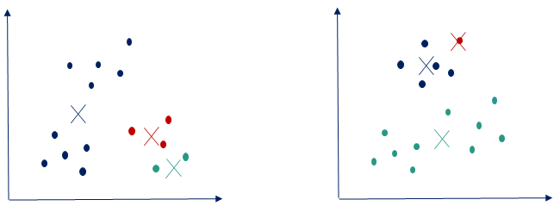
K-Means Algorithm
Choose no: of clusters
Initialization
Assign cluster
Move centroid
Optimization
Convergence
Divide the data points to clusters, once the algorithm converges.

Slide 21
Objective & Goal
Dataset Overview
Approach Design
Visualization Overview
Machine Learning Model
Results
Amazon SageMaker
Future Work & *QR Code

Slide 22
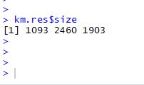
R - Library
library (cluster) –
Finding groups in data
library (ggplot2) –
system for declaratively creating graphs
library (factoextra) –
Used to visualize clusters
(Screenshot taken during evaluation process)

Slide 23
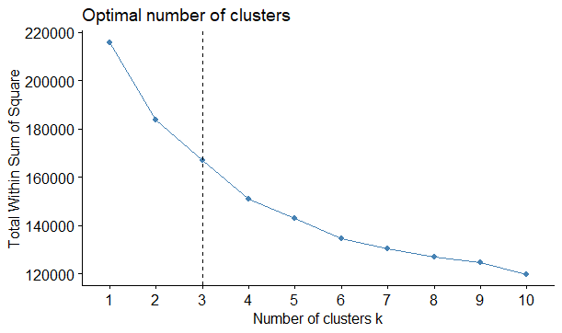
Results - R
Method to validate the number of clusters is the elbow method.
Help finding the appropriate number of clusters in a dataset.
Here, 3 clusters are suggested.
(Screenshot taken during evaluation process)

Slide 24
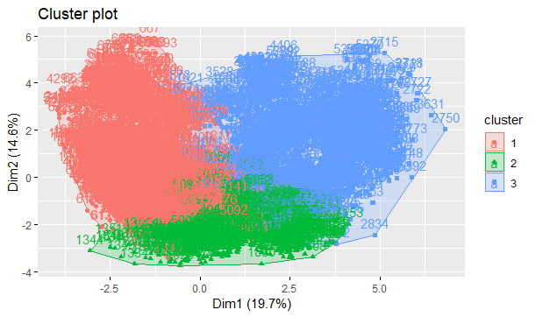
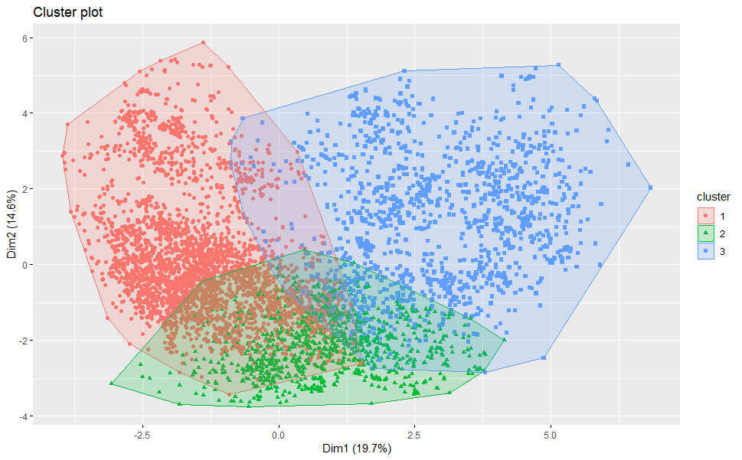
Continue…
As it a multidimensional dataset, to visualize cluster plot PCA is used.
Reduce the dimensionality of a data set consisting of many variables correlated with each other
(Screenshot taken during evaluation process)

Slide 25
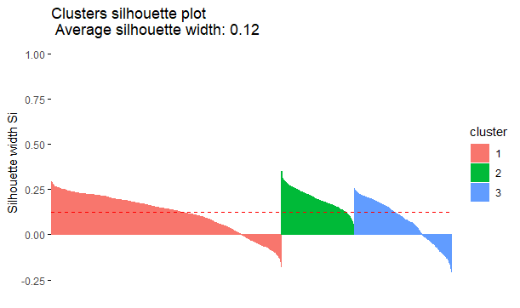

Continue…
Silhouette Plot shows for each cluster:
Each vertical line corresponds to an element.
The average silhouette width
(Screenshot taken during evaluation process)

Slide 26
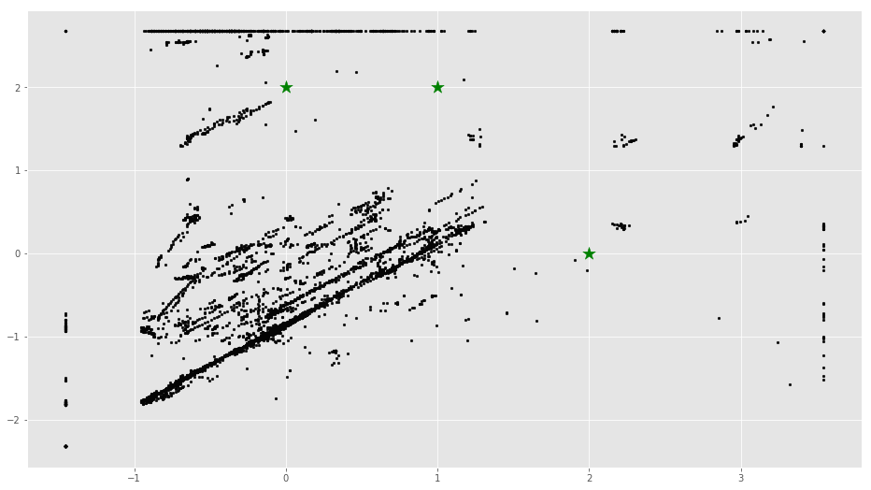
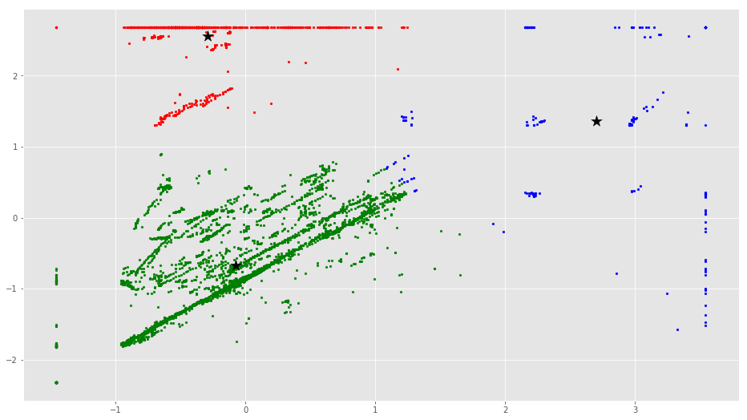
Results - Python
Plot along with random centroid
Assigning new centroid
(Screenshot taken during evaluation process)

Slide 27
Objective & Goal
Dataset Overview
Approach Design
Visualization Overview
Machine Learning Model
Results
Amazon SageMaker
Future Work & *QR Code

Slide 28
Amazon SageMaker

Slide 29
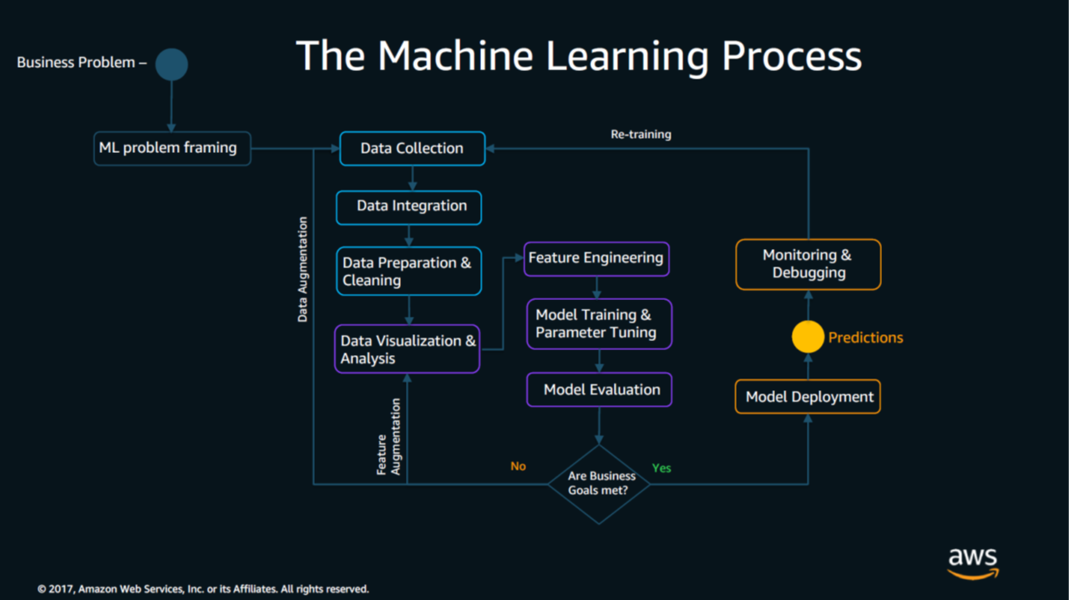
ML Process on AWS

Slide 31
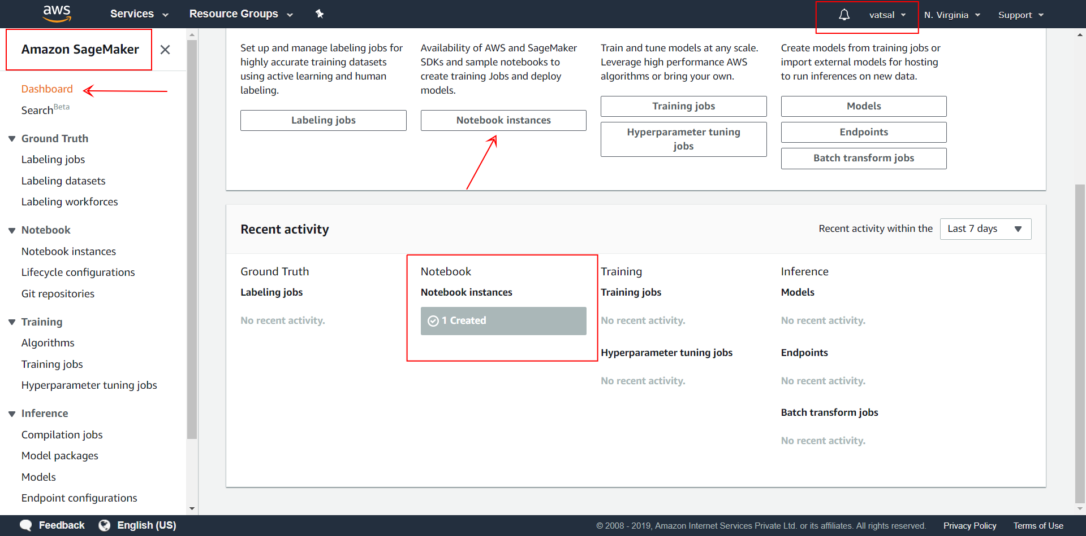
Dashboard

Slide 32
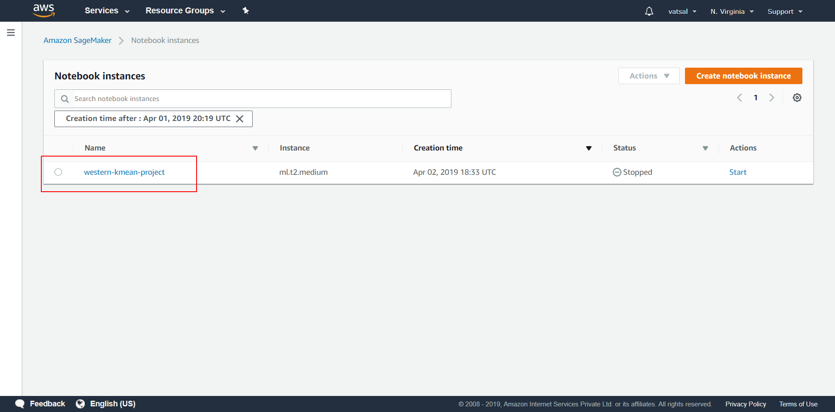
Notebook instances

Slide 33
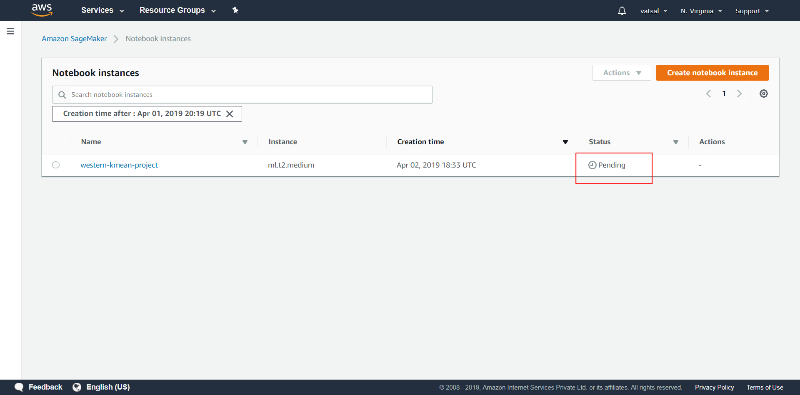
Instance in pending status

Slide 34
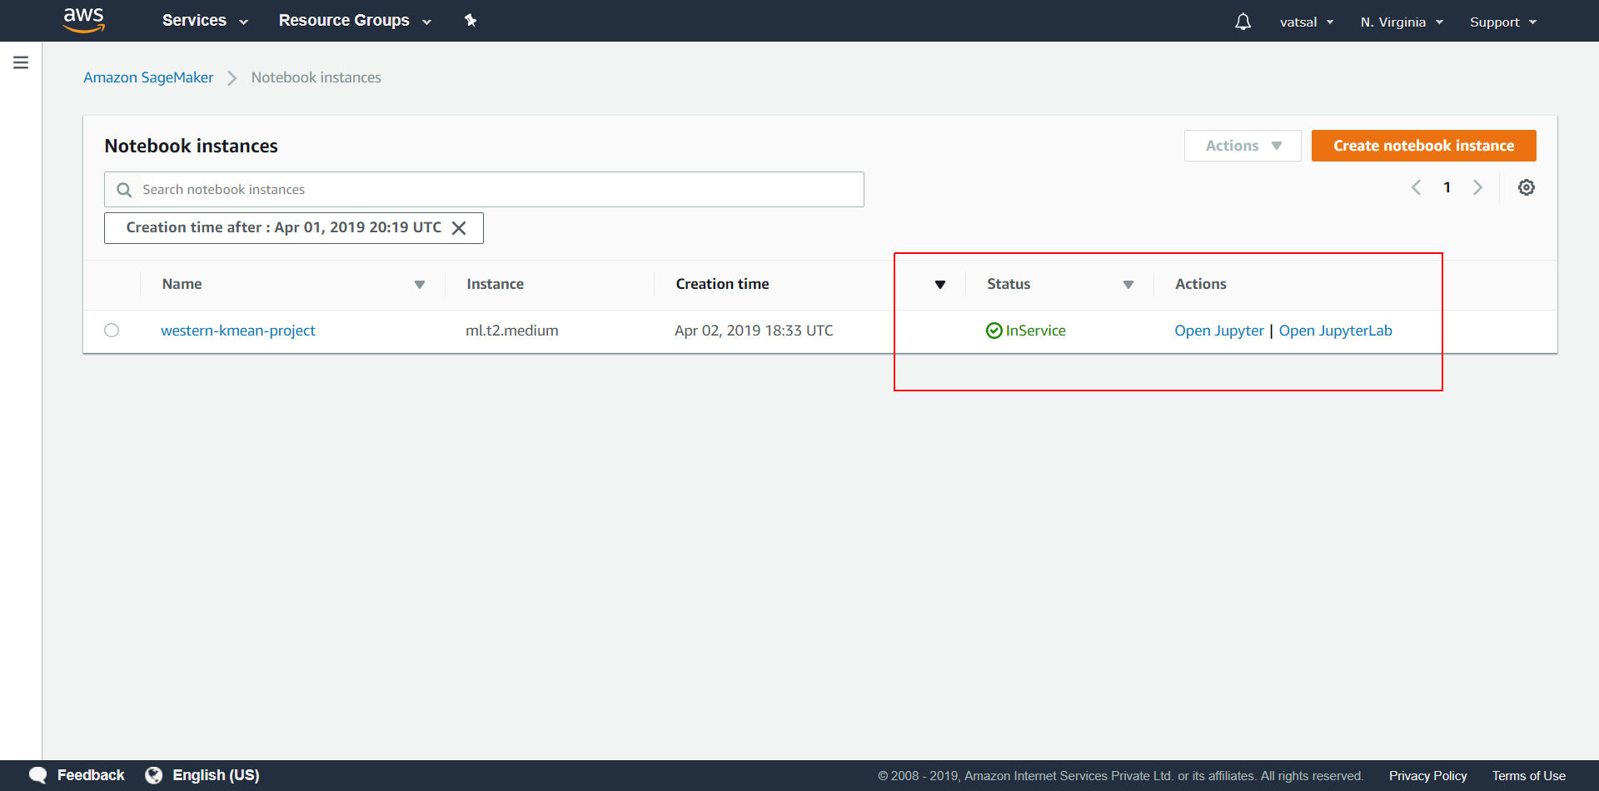
In Service

Slide 35
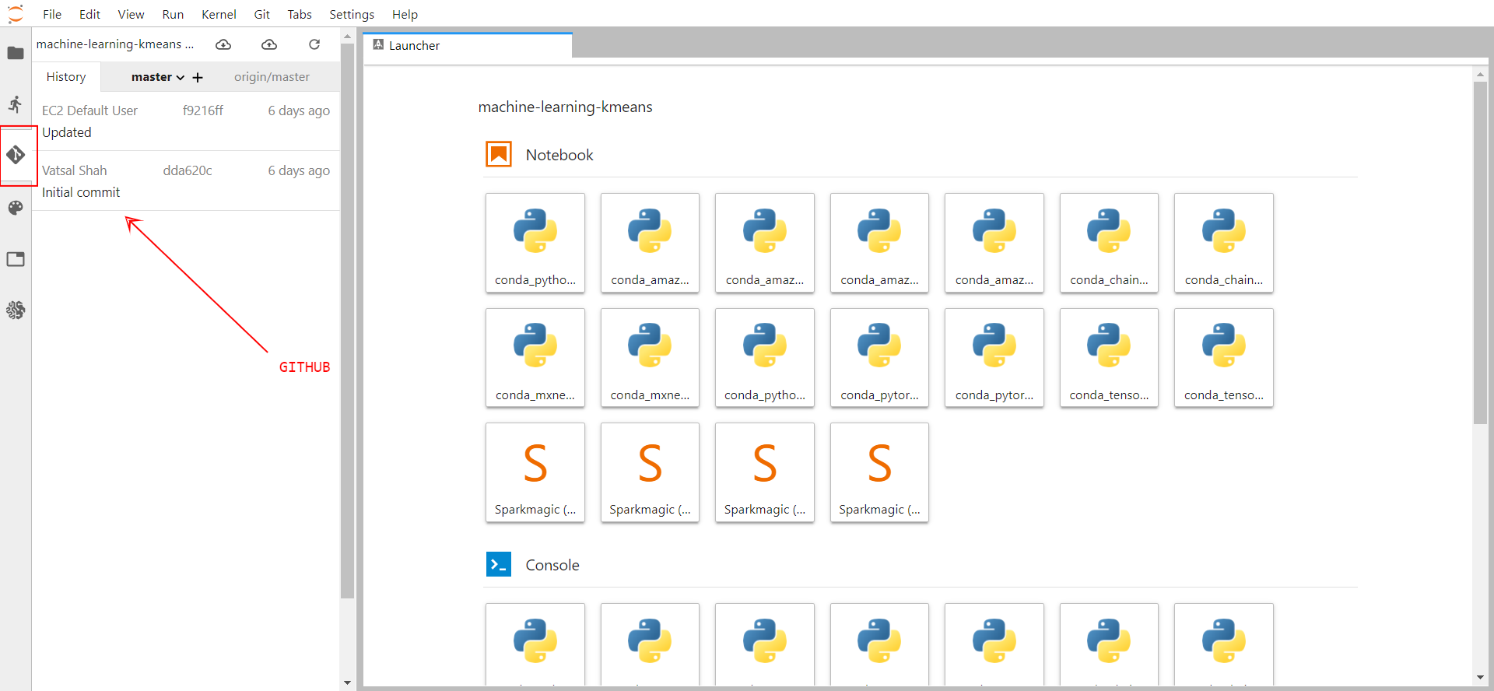
Jupyter Lab

Slide 36
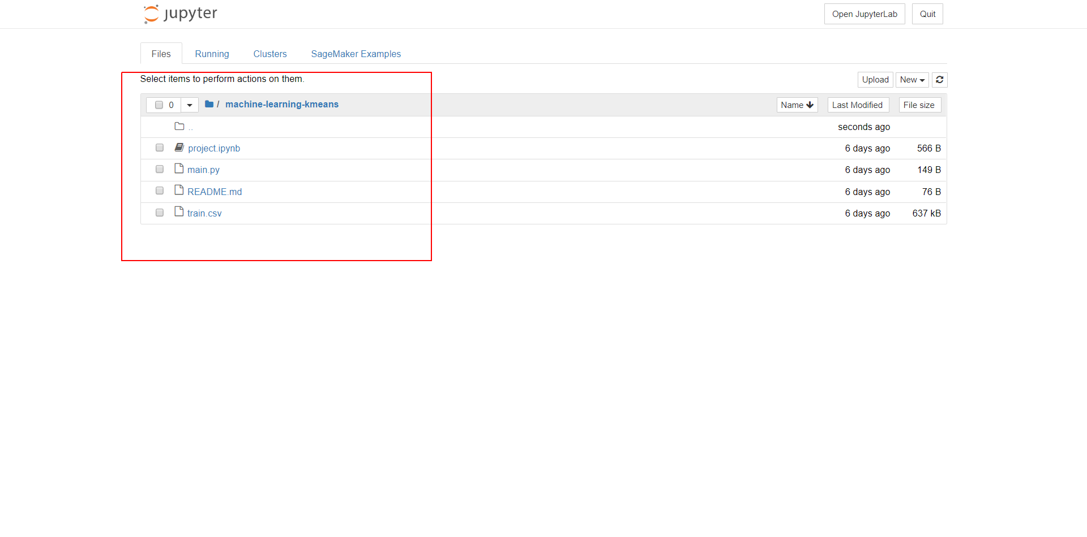
Jupyter

Slide 37
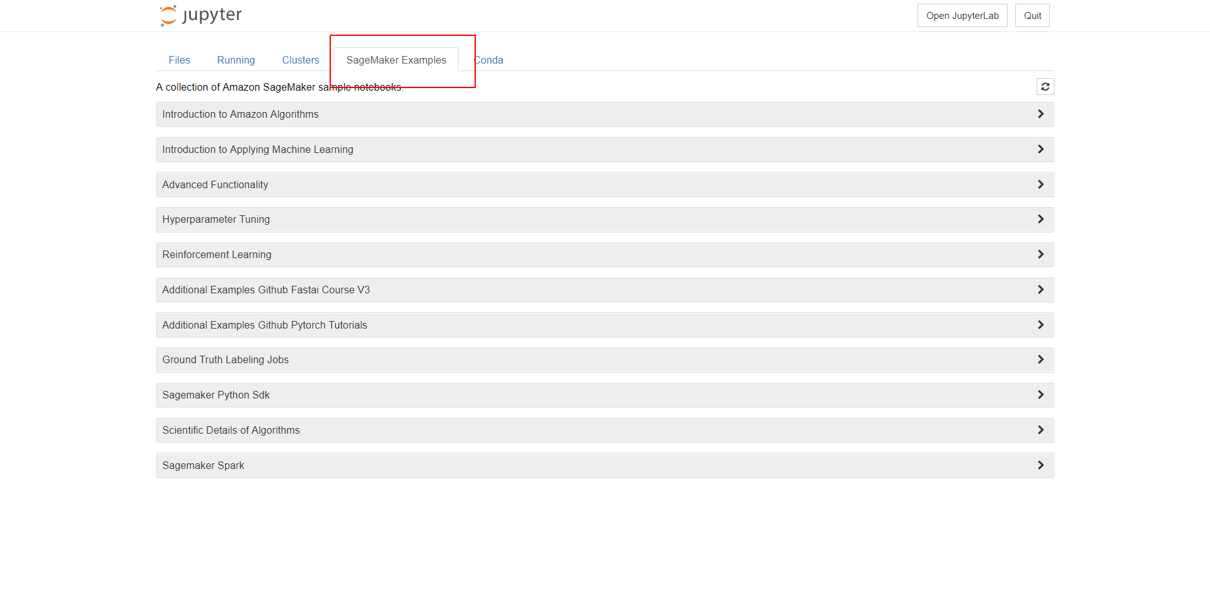
Examples

Slide 38
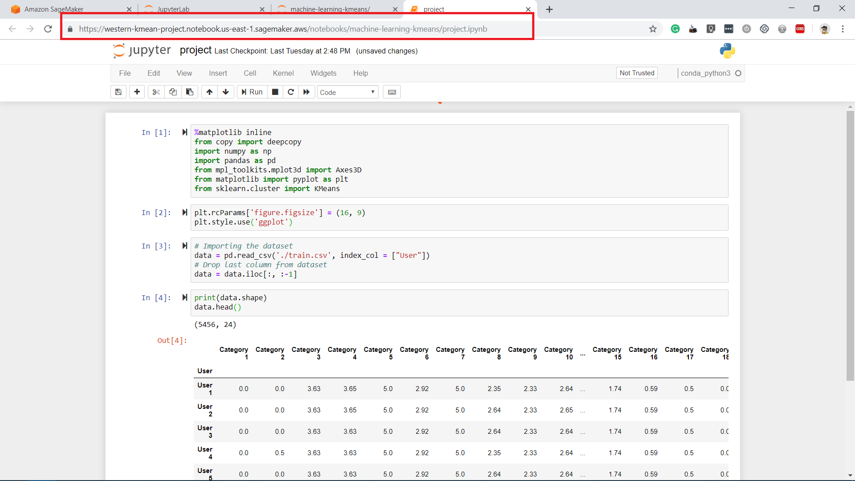
On AWS

Slide 39
Objective & Goal
Dataset Overview
Approach Design
Visualization Overview
Machine Learning Model
Results
Amazon SageMaker
Future Work & *QR Code

Slide 40





Technologies Used

Slide 41
Future work
Find
Find time-complexity with Python, R and Amazon SageMaker
Explore
Explore more with AWS SageMaker services
Apply
Implement unsupervised approach for real world problems

Slide 42
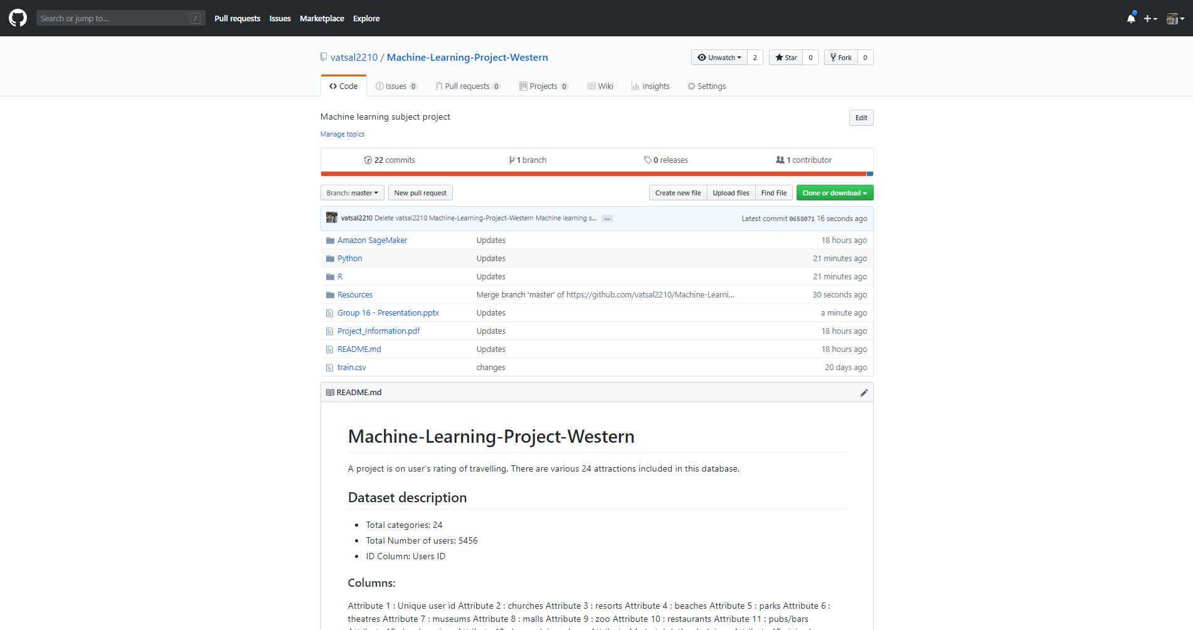

QR Code
Access resources and source code in Python & R

Slide 43
Resources:
Getting started with Amazon SageMaker: Link
Use the Amazon SageMaker SDK: Python: Link
‘Evaluation of Partitioning Clustering Algorithms for Processing Social Media Data in Tourism domain’, Shini Renjith, A. Sreekumar, M. Jathavedan, 2018 IEEE Recent Advances in Intelligent Computational Systems (RAICS) | December 06 - 08, 2018 , Trivandrum Link
‘Use and Impact of Online Travel Reviews’, Markus Schuckert , Liu XianweiRob Law Link
‘Hospitality and Tourism Online Reviews: Recent Trends and Future Directions’, Ulrike Gretzel , Kyung-Hyan Yoo Link
SageMaker Examples: Link
Python vs R Comparison: Link
Python Libraries: Link
R Libraries : Link
K-means Algorithm: Link

Slide 44


Slide 45
THANK YOU

